Slide 1
Path Planning of Robot-assisted Microscopic
Manipulation for sub-retinal injection
Rebecca Richter,
Bastian Pieper, Musfira Naqvi

Slide 2
Agenda
Introduction
Mechanical Design
Code Analysis

Slide 3
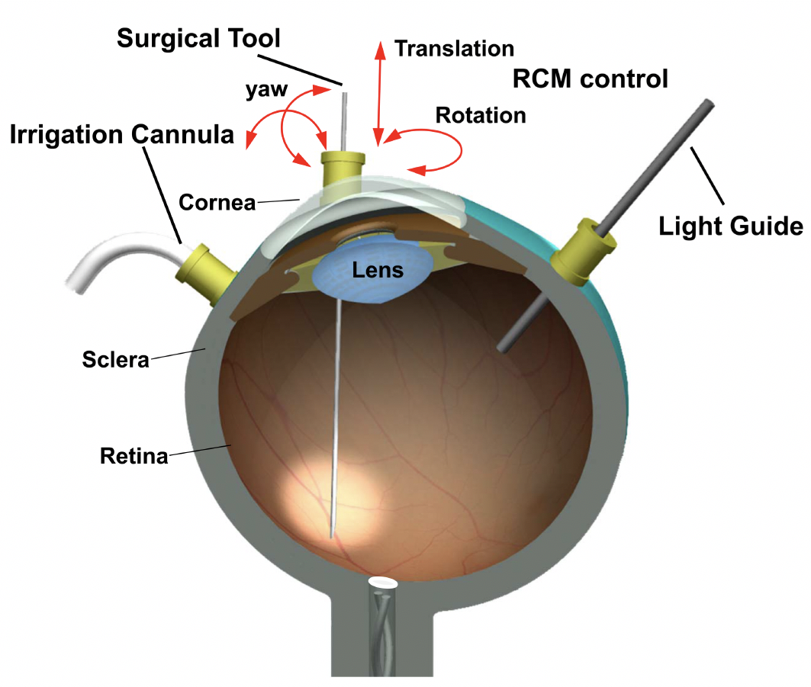
Explanation of the given Task
Design a cycle, square and lovefunction with matlab & Vrep and then with C++. And then
compare the performance of the different
codes.

Slide 4
Introduction
Introduction
Mechanical Design
Code Analysis

Slide 5
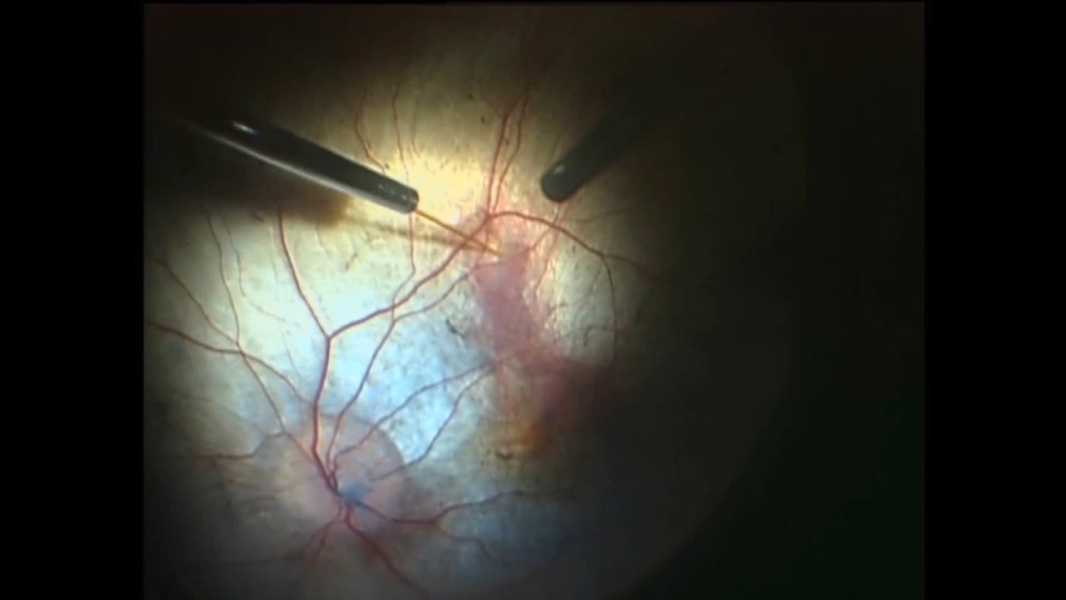
Video of a sub-retinal injection
Introduction

Slide 6
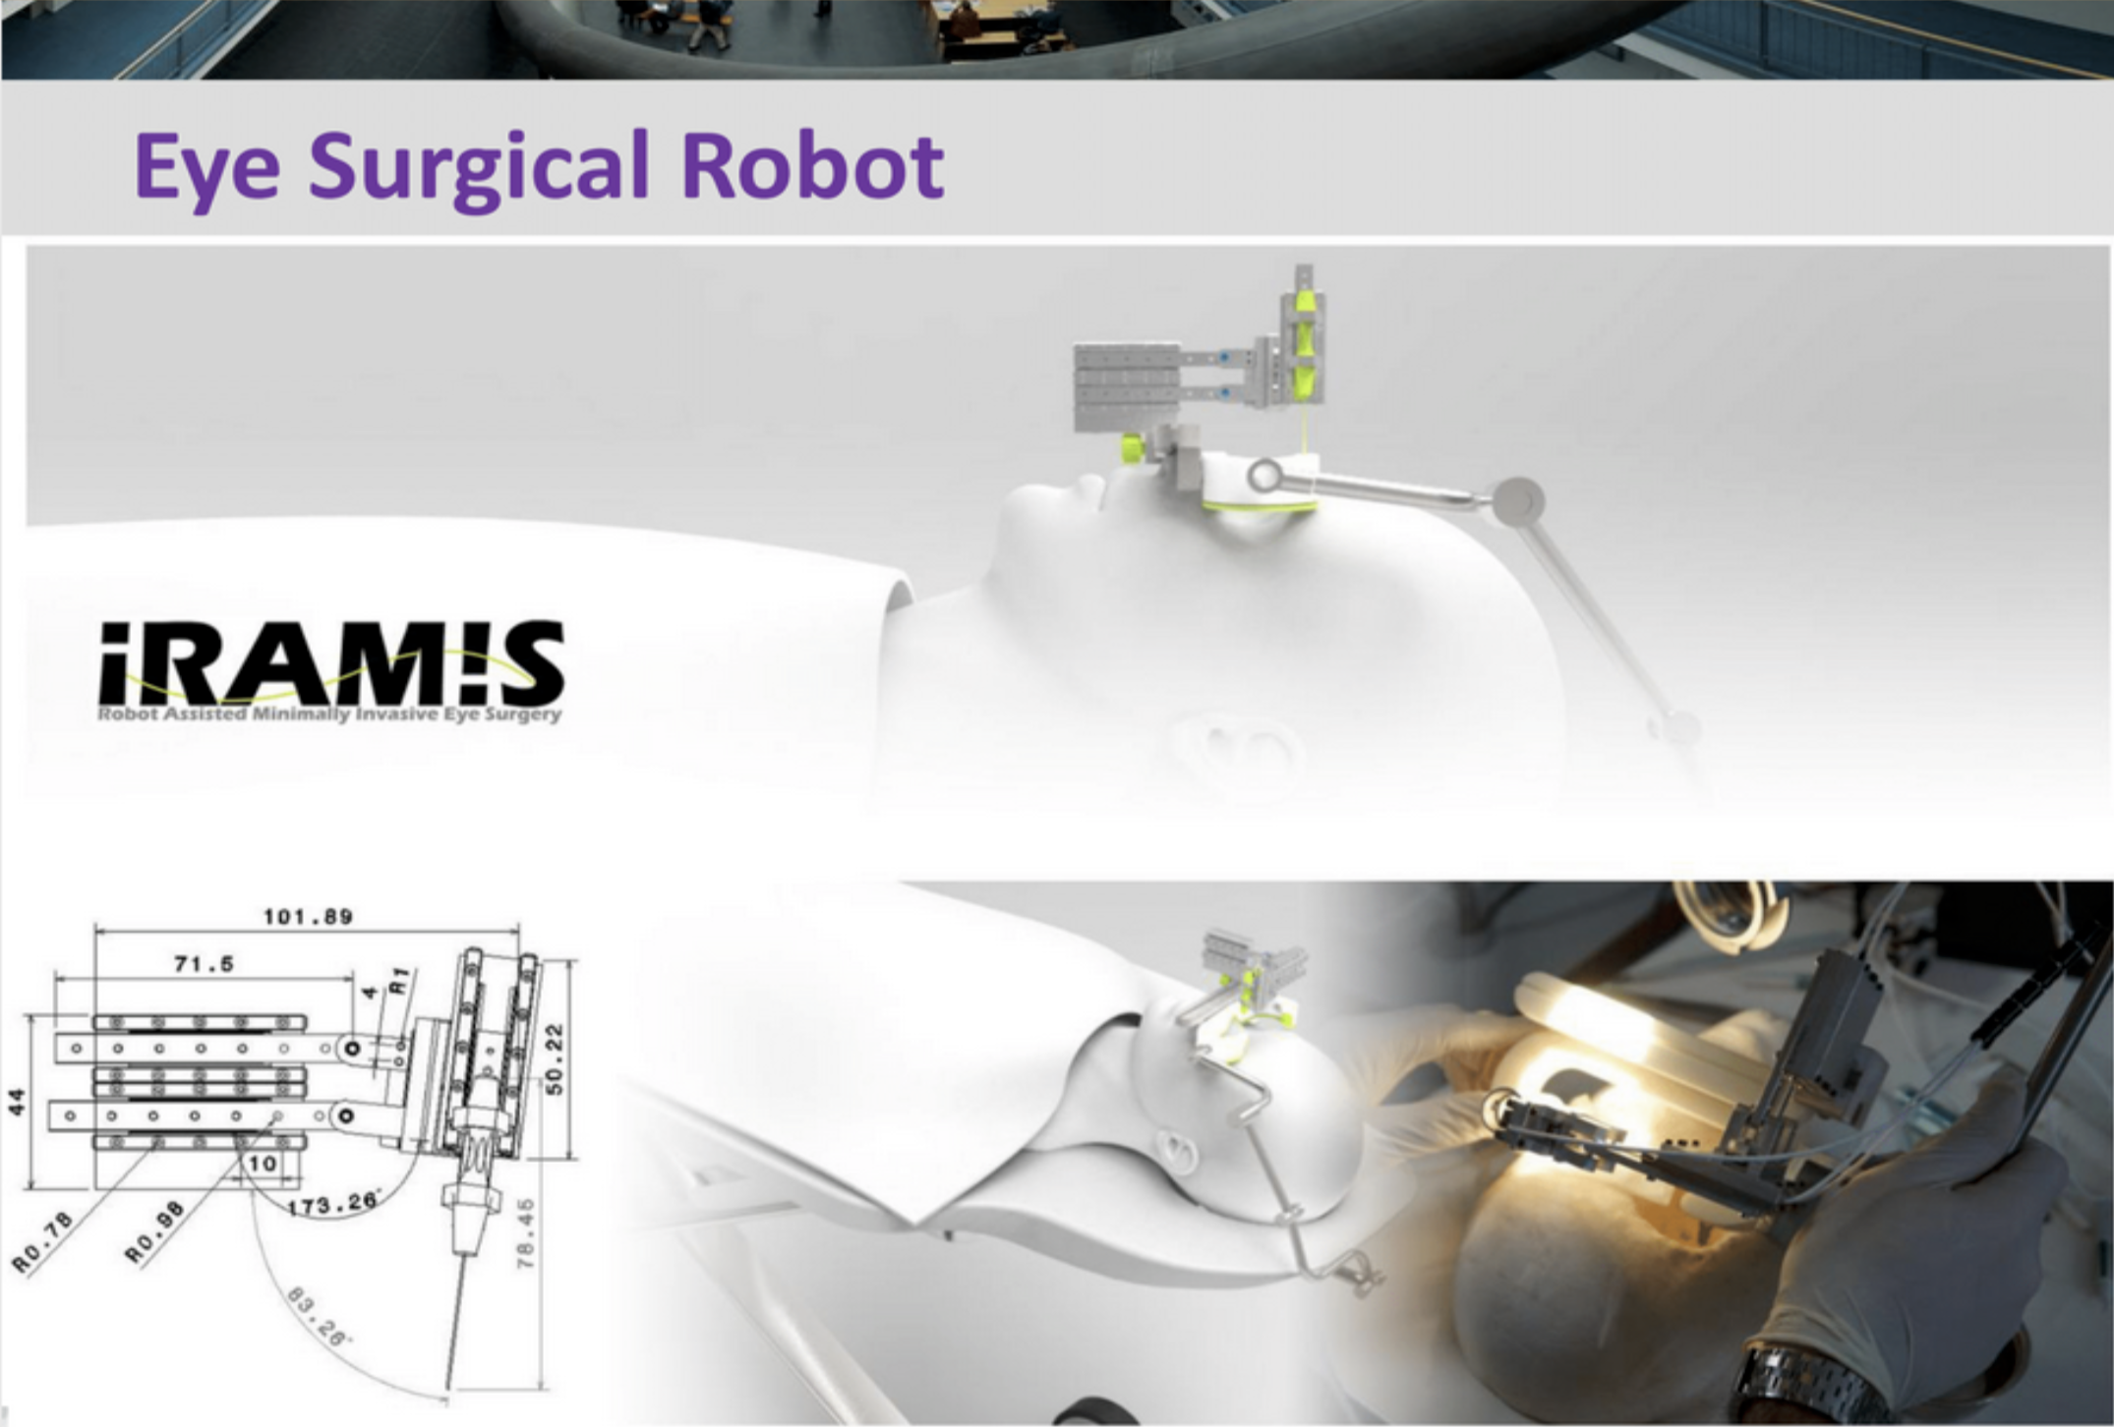
What is an eye surgical robot?
Introduction
Tool that provides smooth, tremor-free position control
Forcescaling of the needle

Slide 7
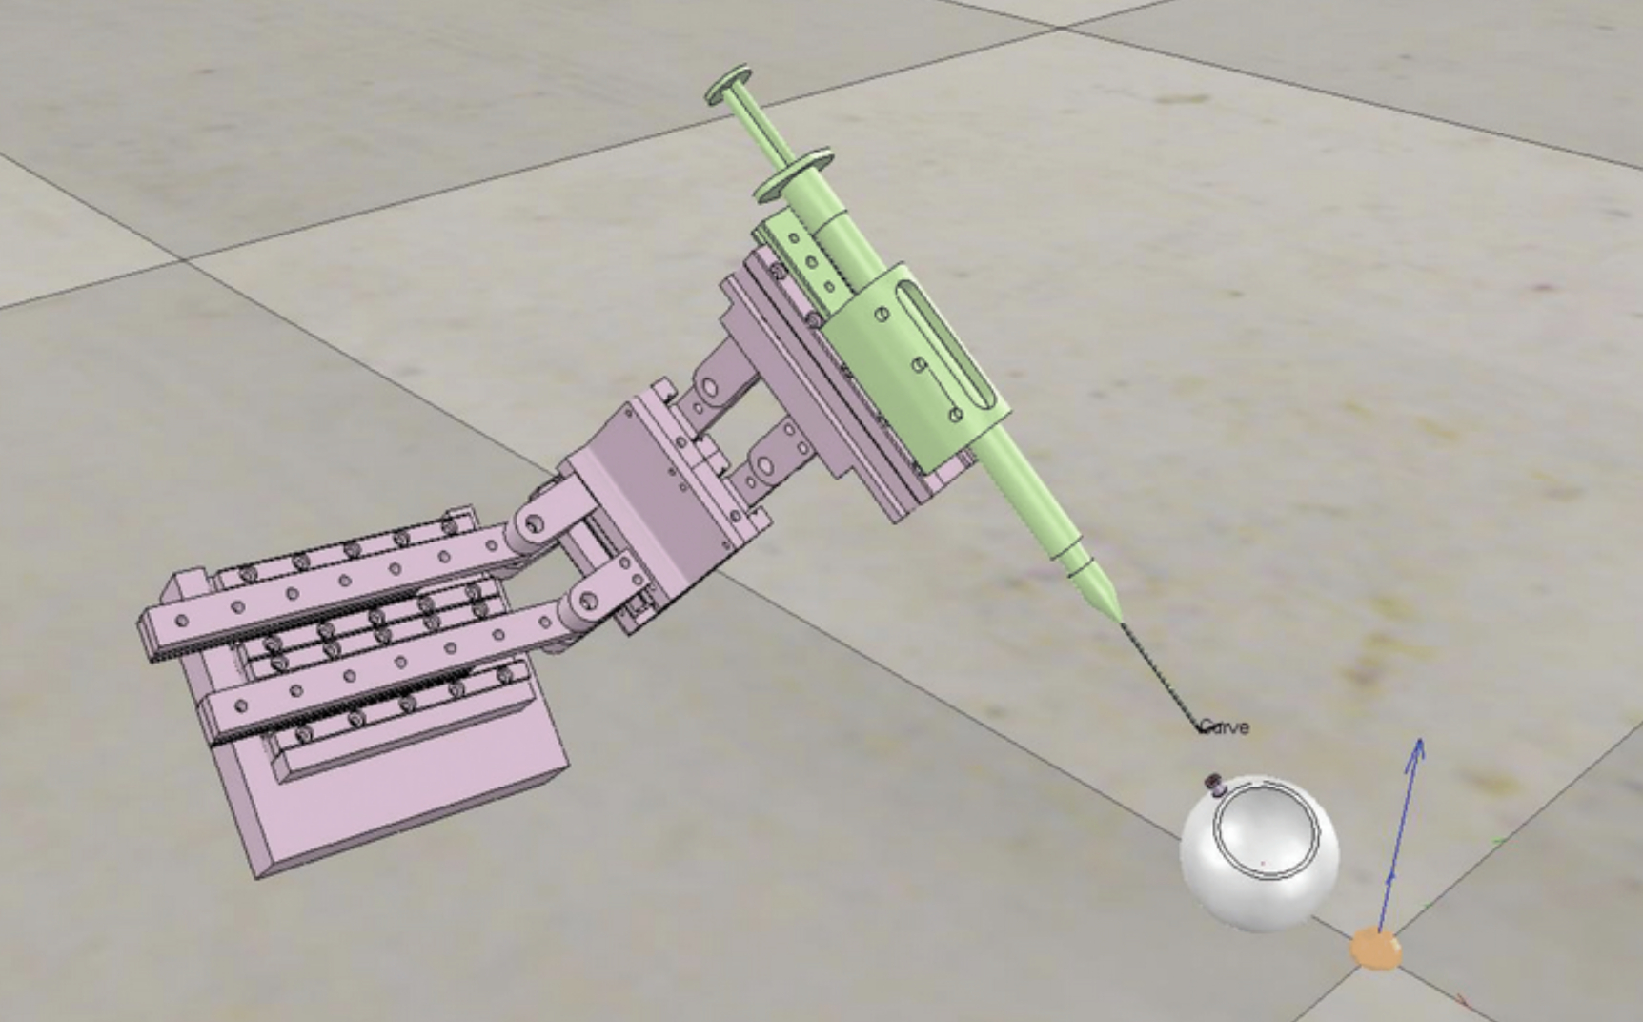
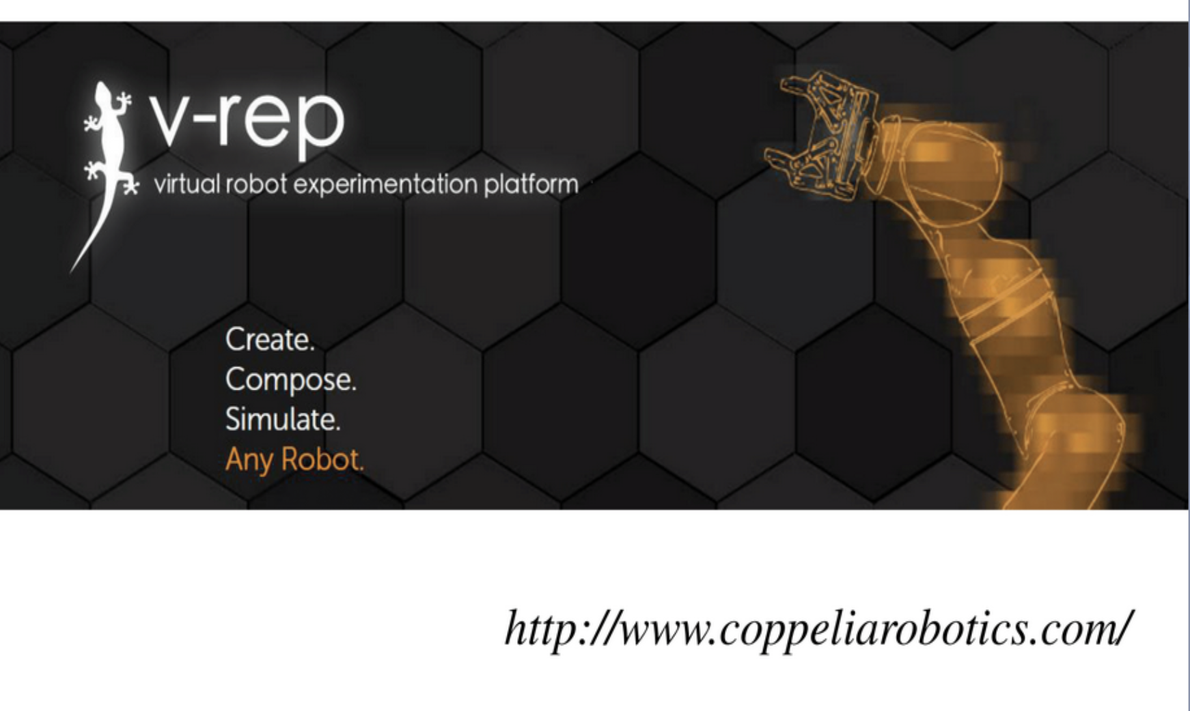
Introduction to v-rep
Introduction

Slide 8
Mechanical Design
Introduction
Mechanical Design
Code Analysis

Slide 9
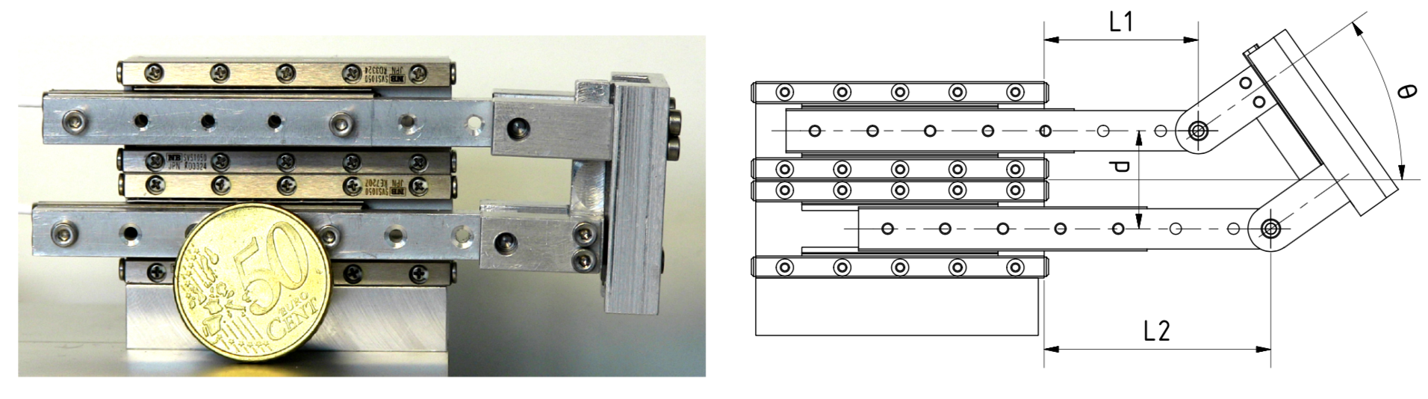
Description of the Parallel Coupled Joint Mechanism
Mechanical Design

Slide 10
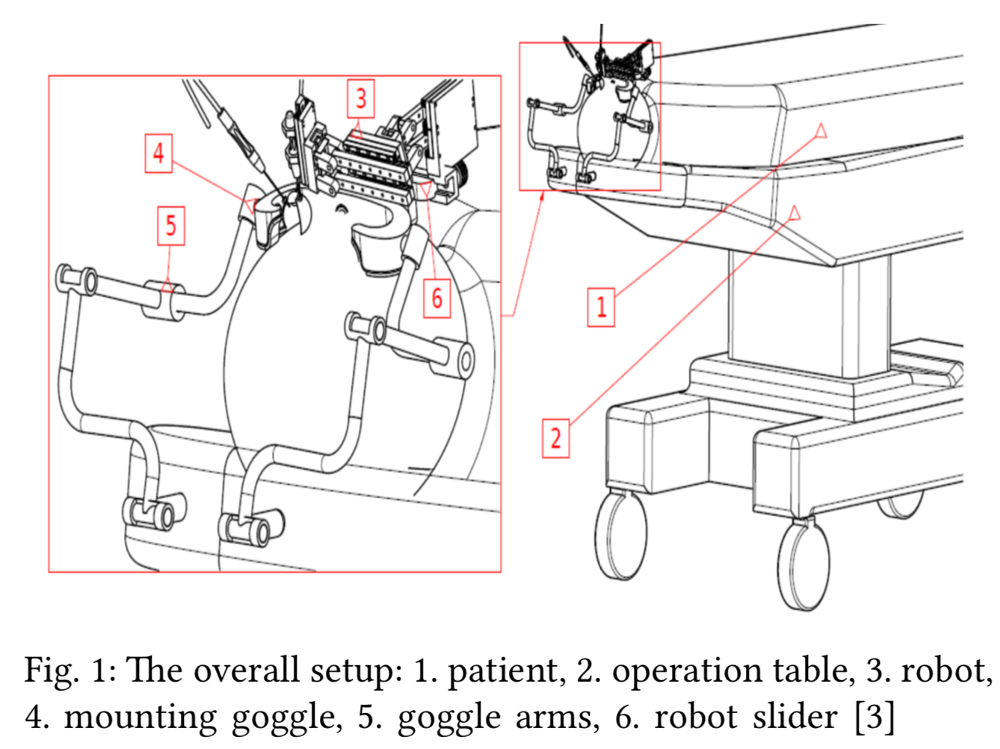
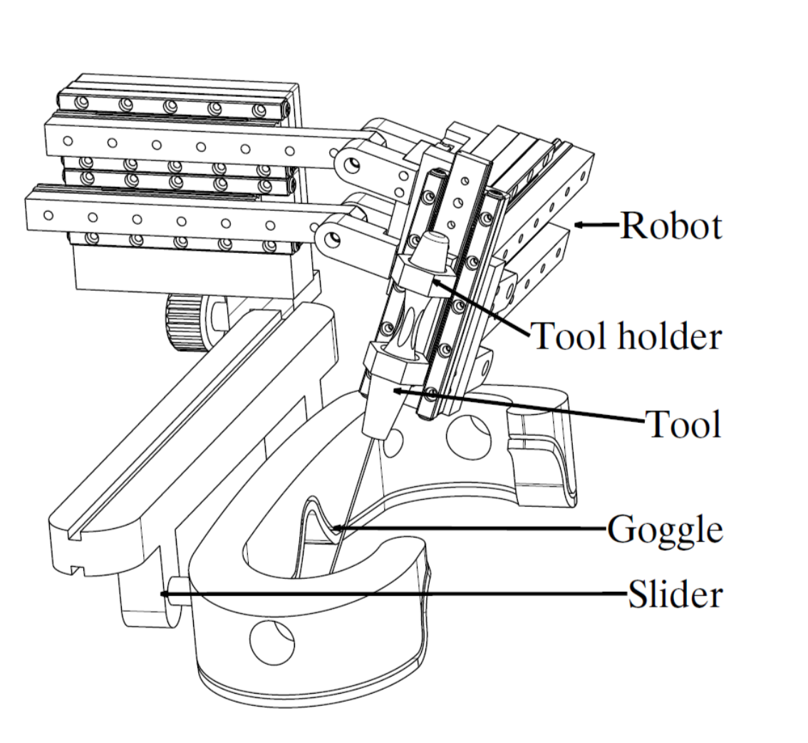
Fixation on Patient
Mechanical Design

Slide 11
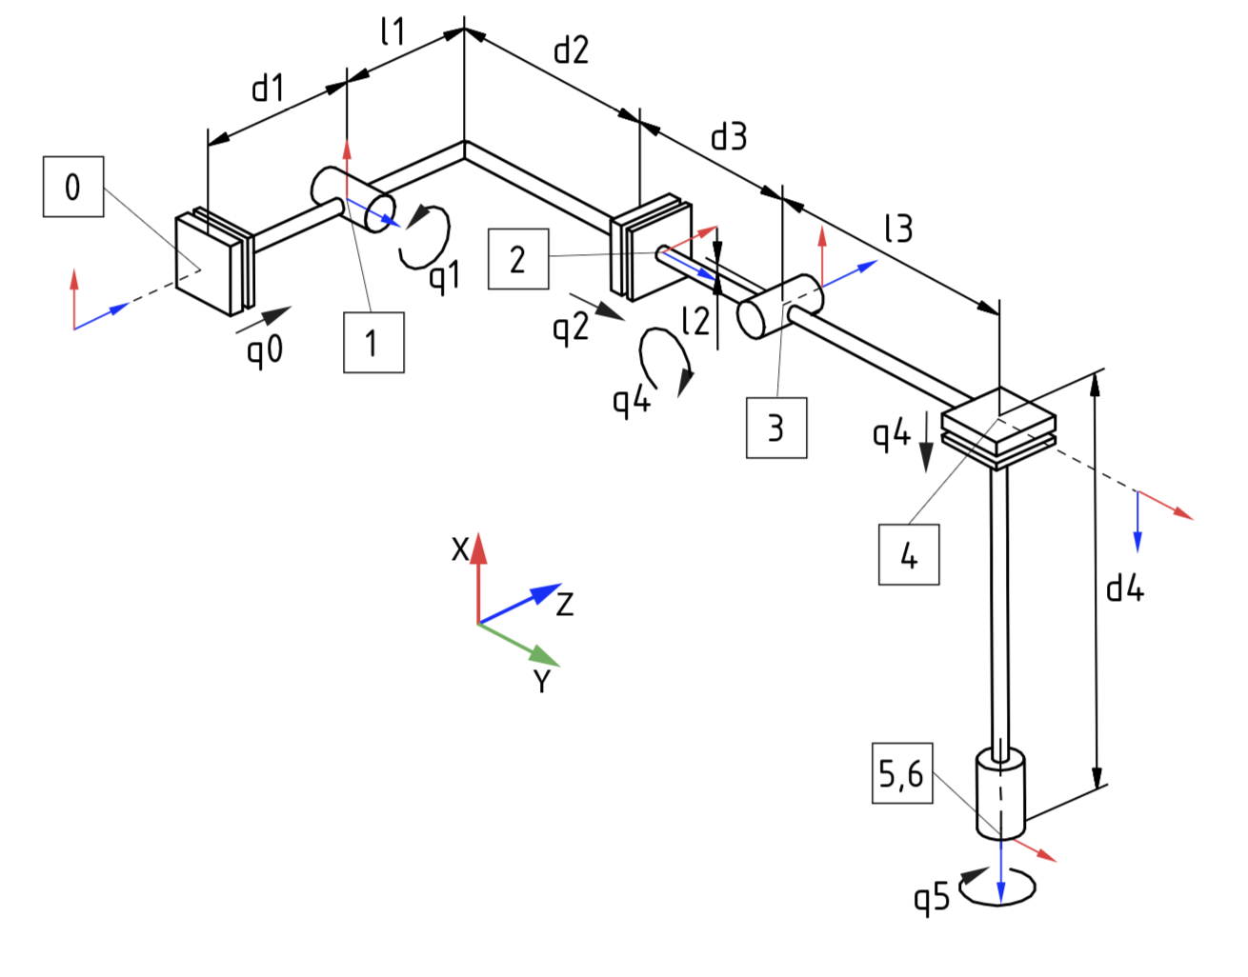
Kinematics Model
Mechanical Design
Use of local Coordinatesystem
Denavit Hartenberg Convention
Desired pose is solution of inverse Kinematics

Slide 12
Kinematics Model
Mechanical Design
Use of local Coordinatesystem
Denavit Hartenberg Convention
Desired pose is solution of inverse Kinematics

Slide 13
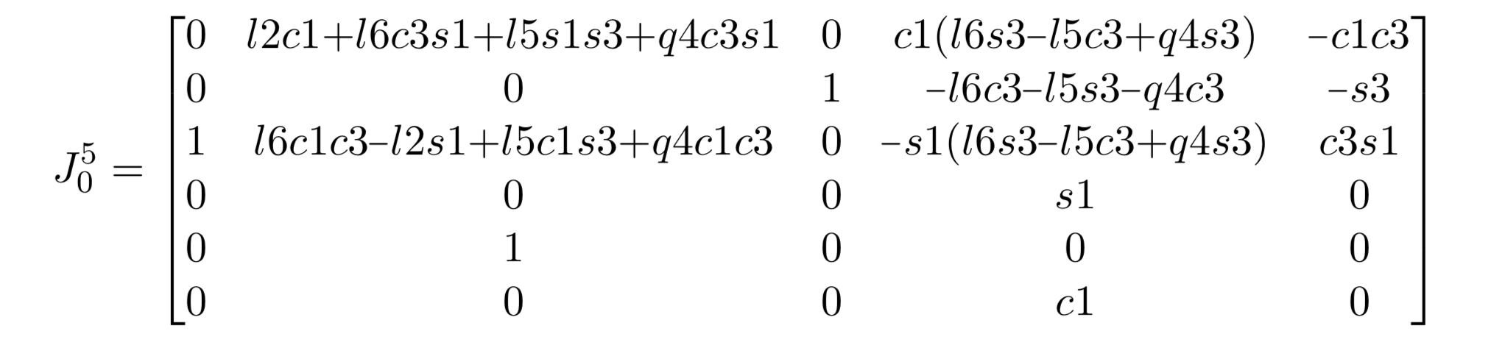
Description of the Parallel Coupled Joint Mechanism
Mechanical Design

Slide 14

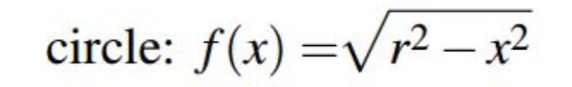
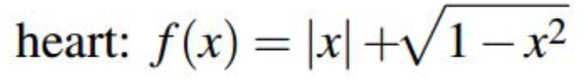
Creation of shapes
Mechanical Design

Slide 15
Code Analysis
Introduction
Mechanical Design
Code Analysis

Slide 16
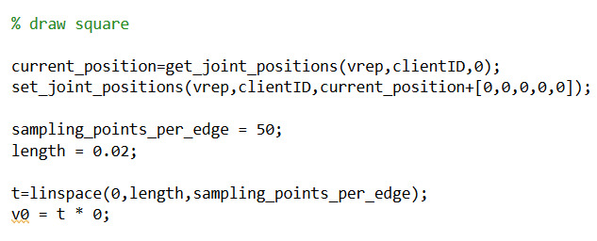
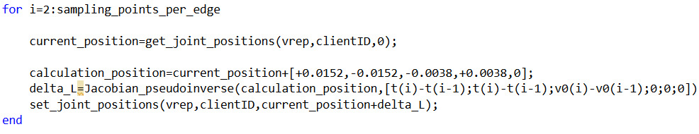
Draw Square Function
Code Analysis

Slide 17
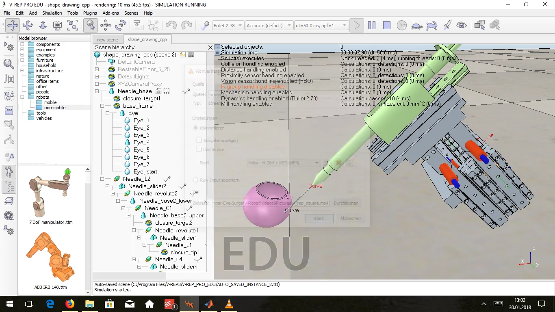
Video Draw Square Function
Code Analysis

Slide 18
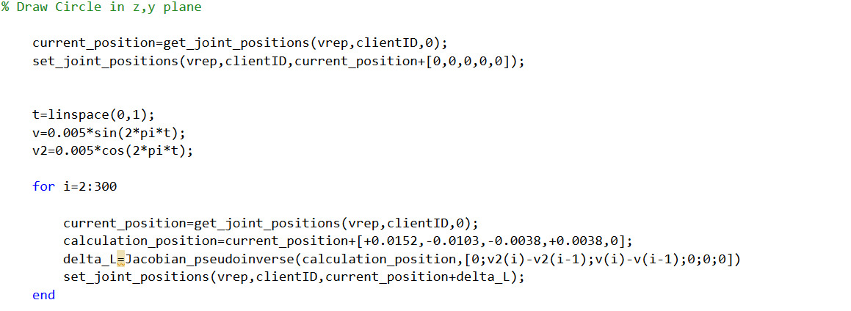
Draw Circle Function
Code Analysis

Slide 19
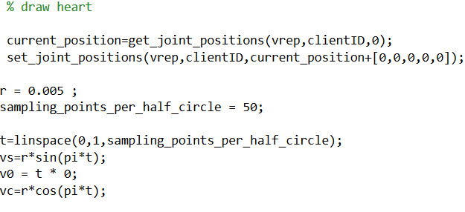
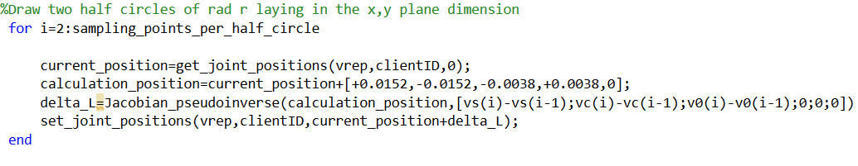
Draw Heart Function
Code Analysis

Slide 20
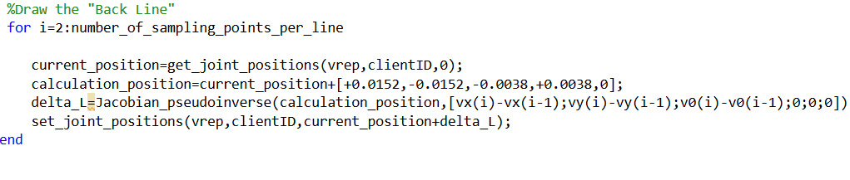
Draw Heart Function
Code Analysis

Slide 21
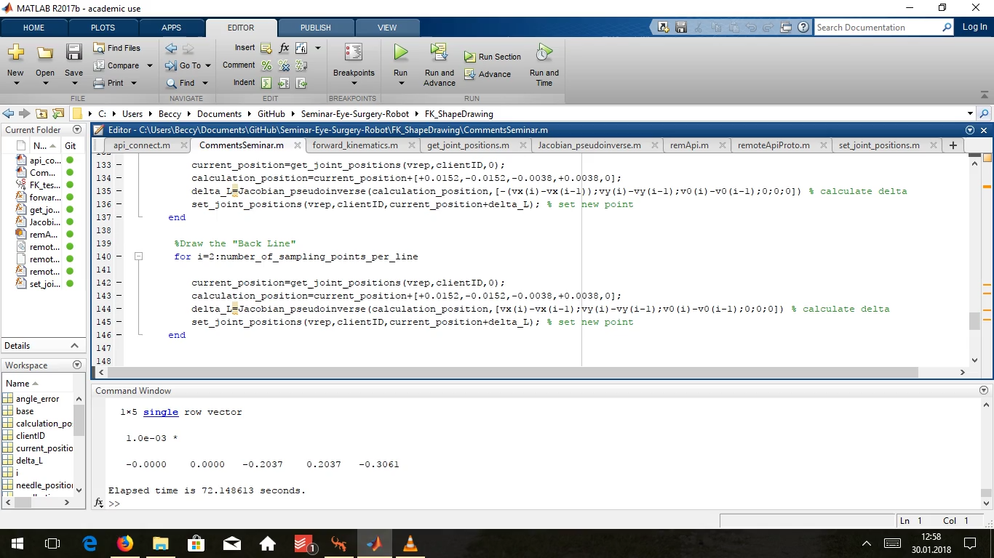
Video Draw Heart Function
Code Analysis

Slide 22
Thank you for your attention

